Slide 1

Convention Centre Management (CCM) Project Customer Bill of Rights & Responsibilities

Slide 2

HIGHLIGHT
BRIEF INTRODUCTION - CONVENTION CENTRE MANAGEMENT (CCM)
IMPORTANCE OF IMPLEMENTING A DATABASE SOLUTION
CUSTOMER BILL OF RIGHTS
CUSTOMER RESPONSIBILITIES
JUSTIFICATION
RECOMMENDATIONS
CONCLUSION

Slide 3
BRIEF INTRODUCTION - CONVENTION CENTRE MANAGEMENT
The business scenario revolves around the management of a convention centre, where two venues, THE CITY DOME and THE CONVENTION CENTER, host various events and gatherings

Slide 4

IMPORTANCE OF IMPLEMENTING A DATABASE SOLUTION
Implementing a database solution is crucial for the following:
Automating the scheduling process at the Convention Centre Management
Increased Efficiency
Error Reduction
Improved Customer Service: Accurate Reporting
Streamlined Operations

Slide 5

CUSTOMER BILL OF RIGHTS
ACCURATE & EFFICIENT RESERVATION MANAGEMENT : Customers have the right to an automated and error-free reservation system
USER-FRIENDLY INTERFACE: Customers have the right to a simple and intuitive data entry interface
ACCESS TO VENUE INFORMATION: Customers can expect assistance in choosing suitable venues based on event requirements
RECORD OF CANCELED RESERVATIONS: Customers' canceled reservations will be recorded for future follow-ups and analysis
QUALITY REPORTING: Customers will receive comprehensive and accurate reports on reservations and events

Slide 6

CUSTOMER RESPONSIBILITIES
PROVIDE CLEAR REQUIREMENTS:Customers are responsible for providing detailed database solution requirements
COOPERATION WITH BUSINESS ANALYSTS:Customers must cooperate with analysts to understand their business needs
FEEDBACK AND CHANGES:Customers should provide timely feedback and request necessary changes during development
DATA ACCURACY:Customers are responsible for providing accurate data
TIMELY COMMUNICATION:Customers should maintain open and timely communication with the scheduling office

Slide 7

JUSTIFICATION
ACCURATE & EFFICIENT RESERVATION MANAGEMENT :The current manual process is error-prone and time-consuming, leading to frustration and inefficiencies for both customers and staff
USER-FRIENDLY INTERFACE:The current disorganized process causes mistakes, resulting in a need for a straightforward and user-friendly interface
ACCESS TO VENUE INFORMATION:Assisting customers in choosing suitable venues improves customer relations and ensures better event planning

Slide 8
JUSTIFICATION
QUALITY REPORTING: Manual typing of reports is time-consuming and error-prone
RECORD OF CANCELED RESERVATIONS: Keeping records of canceled reservations enables follow-ups, identifies patterns, and enhances customer service

Slide 9

RECOMMENDATIONS
ACCURATE & EFFICIENT RESERVATION MANAGEMENT : Implement an automated reservation system with real-time availability checking to prevent double-bookings
USER-FRIENDLY INTERFACE :Design an intuitive interface with clear instructions and error validation to ensure easy data entry
ACCESS TO VENUE INFORMATION:Develop a feature that allows staff to assist customers in finding suitable venues based on event size and requirements

Slide 10
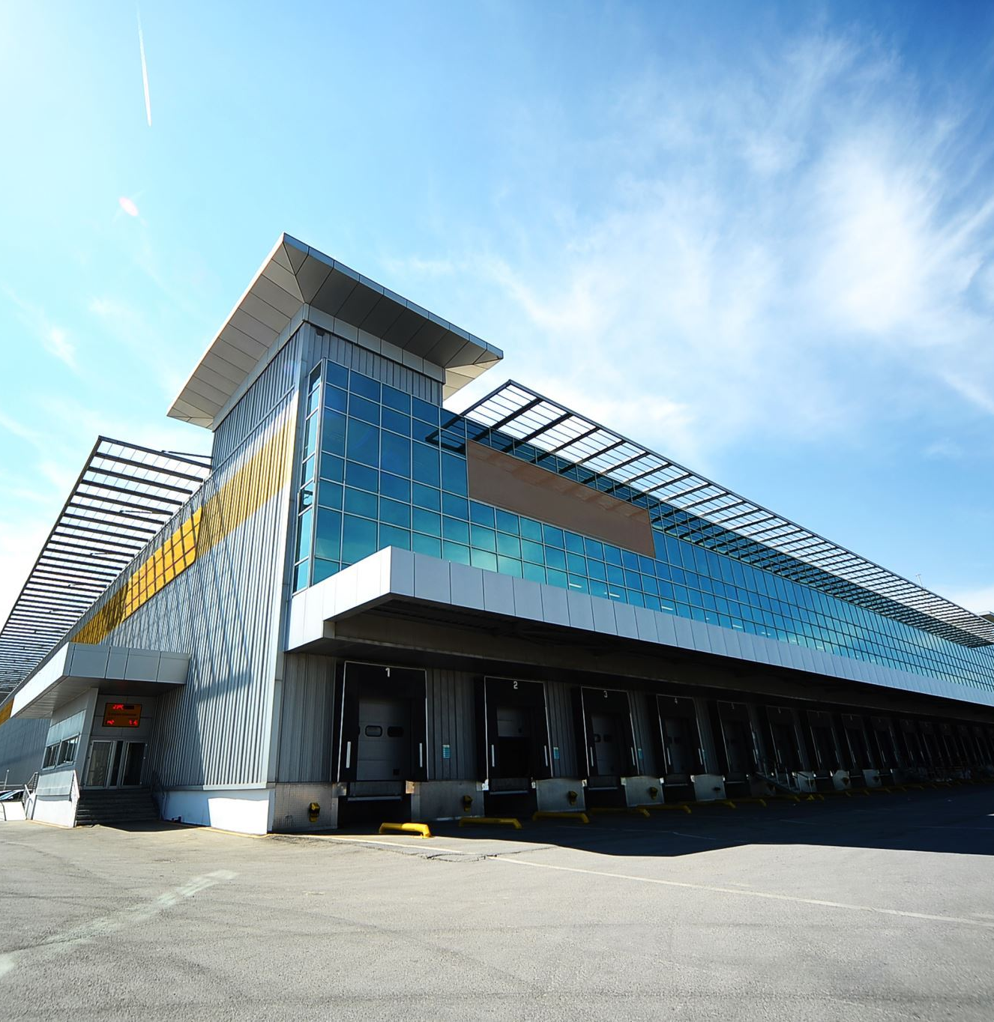
CONCLUSION
By incorporating these recommendations into the Customer Bill of Rights & Responsibilities, the Convention Centre Management system will be equipped to provide a streamlined, user-friendly, and efficient experience for customers, leading to enhanced customer satisfaction and improved business operations

Slide 11


Thank You
Thank you for your attention!!!

